Slide 1
Searching for Kuiper Belt Objects
Deborah L. Hamm
Mentors David Trilling, Cesar Fuentes,
Michael Mommert, Paulo Penteado

Slide 2
Kuiper Belt Objects (KBOs)
Rocky, icy bodies
Located ~ 30-50 AU
Remnants of the era of planet formation
~1000 known
Only a few tens @ R > 24

Slide 3
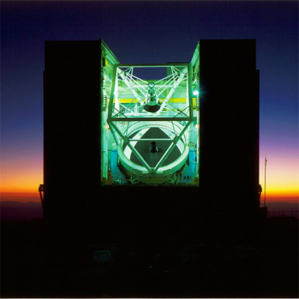
Instruments / Data
6.5 meter telescopes
36 CCD mosaic camera MEGACAM
36 Fields
R magnitude limiting depth of ~25.2

Slide 4
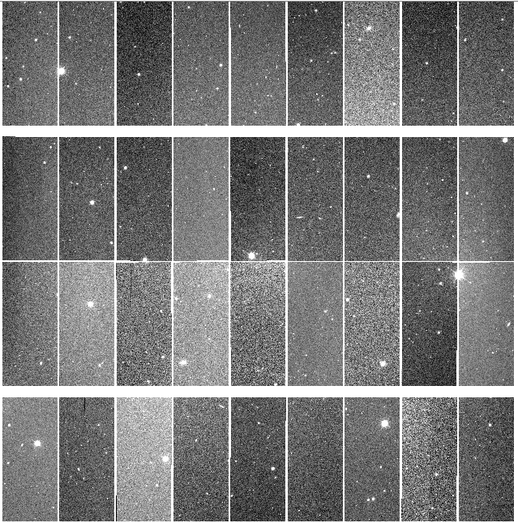
MEGACAM Mosaic
36 CCDs
9 X 4 array
FOV:
24’ X 24’
.16 deg²
FOV (1 CCD):
160’’ X 360’’
Gaps ~6’’

Slide 5
Expectations
Expectations based on previous studies
4 KBOs in a single pointing
3-5 arcseconds/hr for a KBO @ 30 AU

Slide 6
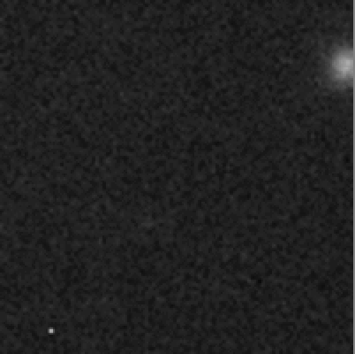
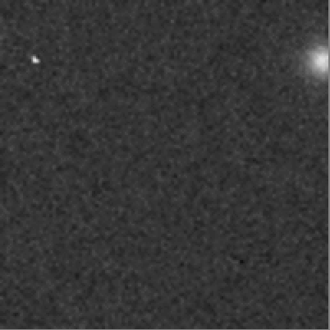
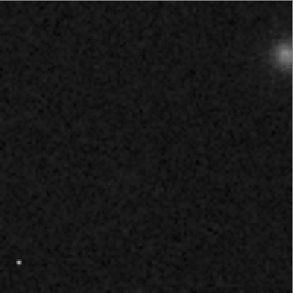
Candidate Validation

Slide 7
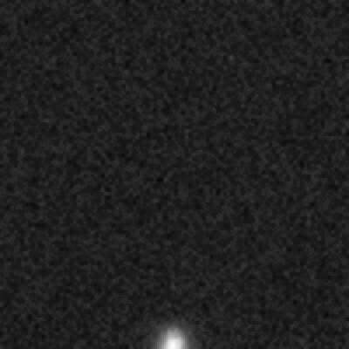
KBO?

Slide 8
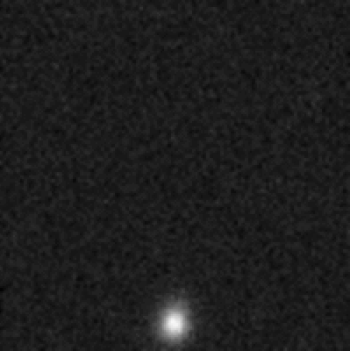
KBO?

Slide 9
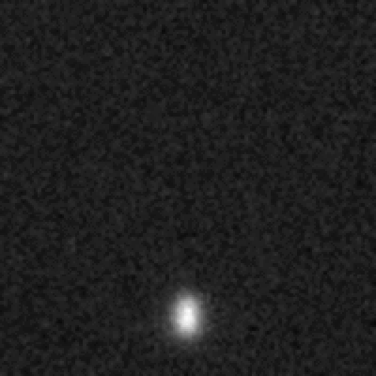
KBO?

Slide 10
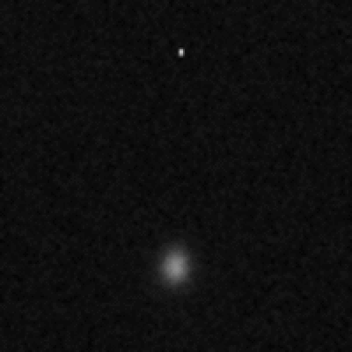
KBO?

Slide 11
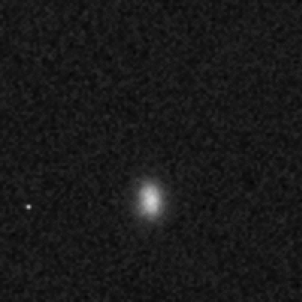
KBO?

Slide 12
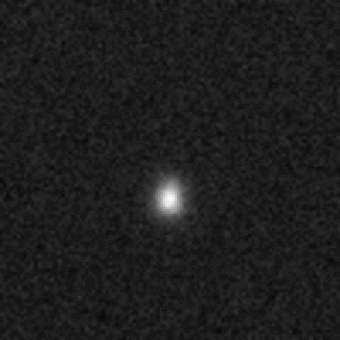
KBO?

Slide 13
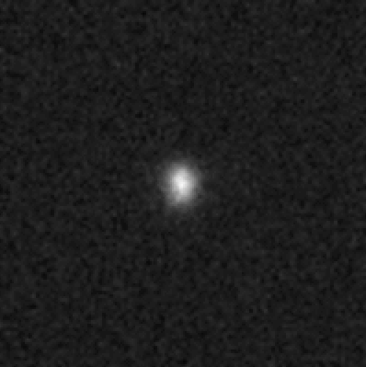
KBO?

Slide 14
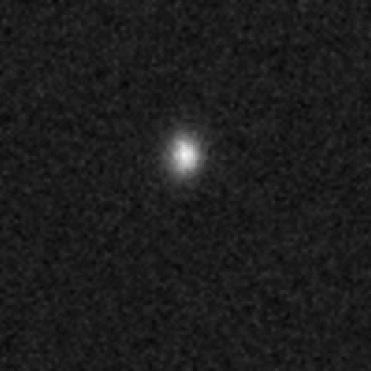
KBO?

Slide 15
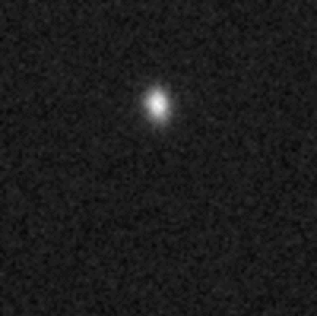
KBO?

Slide 16
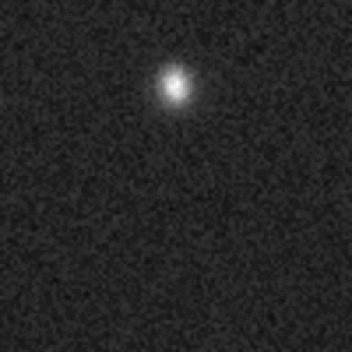
KBO?

Slide 17
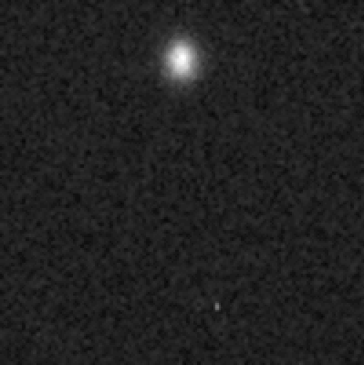
KBO?

Slide 18
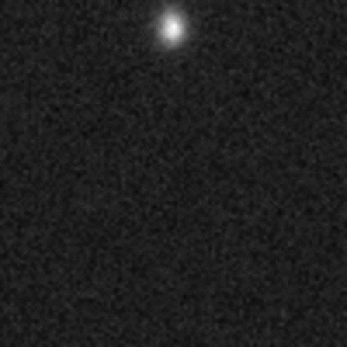
KBO?

Slide 19
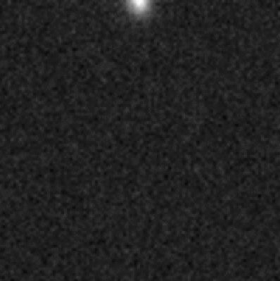
KBO?

Slide 20
Next Steps
Search algorithm
Gif files
Run dataset

Slide 21
Thank You
Mentors: David Trilling, Cesar Fuentes, Michael Mommert, Paulo Penteado
NASA Space Grant
Arizona Space Grant Consortium
Northern Arizona University
University of Arizona

